Slide 1


^{BIKE RENTAL PROJECT}
Ms. POTLACHERVU SRILATHA | srilathapotlacheruvu0011@gmail.com
Guidance by:
Aishwarya Ajay Mate

Slide 2


EDA
Splitting dataset
Encoding
Modelling
Cross Validation
Model performance
Model metrics
Model Tuning
Conclusions

Slide 3

Problem Statement
To build a model that accurately predicts the count of bikes rented on daily based on a particular day depending on different environmental, seasonal changes.

Slide 4
Data Set Details
Data contains previous information on bike bookings based on some features.
Data set has 17379 rows and 17 columns
instant | dteday | season | yr | mnth | hr | holiday | weekday | workingday | weathersit | temp | atemp | hum | windspeed | casual | registered | cnt
0 | 1 | 01-01-2011 | springer | 2011 | 1 | 0 | No | 6 | No work | Clear | 0.24 | 0.2879 | 0.81 | 0 | 3 | 13 | 16
1 | 2 | 01-01-2011 | springer | 2011 | 1 | 1 | No | 6 | No work | Clear | 0.22 | 0.2727 | 0.8 | 0 | 8 | 32 | 40
2 | 3 | 01-01-2011 | springer | 2011 | 1 | 2 | No | 6 | No work | Clear | 0.22 | 0.2727 | ? | 0 | 5 | 27 | 32
3 | 4 | 01-01-2011 | springer | 2011 | 1 | 3 | No | 6 | No work | Clear | 0.24 | 0.2879 | 0.75 | 0 | 3 | 10 | 13
4 | 5 | 01-01-2011 | springer | 2011 | 1 | 4 | No | 6 | No work | Clear | 0.24 | 0.2879 | 0.75 | 0 | 0 | 1 | 1
Sr.No | Column Name | Column Description
1 | Instant | Index number
2 | Dteday | Date (Format: YYYY-MM-DD)
3 | Season | Season Name
4 | Yr | Year
5 | Month | Month (1-12)(Jan-Dec)
6 | Hr | Hour(0 to 23)
7 | Holiday | Whether the holiday is there or not
8 | Weekday | Day of the week
9 | Workingday | Whether it is a working day or not
10 | Weathersit | Weather situation
11 | Temp | Normalized temperature in Celsius
12 | Atemp | Normalized feeling temperature
13 | Hum | Normalized humidity. The Values are divided by 100
14 | Windspeed | Normalized Wind speed. Values are divided by 67
15 | Casual | Count of casual users
16 | Registered | Number of registered users
17 | Cnt | Count of total rental biked including both casual and registered

Slide 5
Exploratory Data Analysis Steps
Imported Libraries
In this part, we imported the required libraries NumPy, Pandas, matplotlib, and seaborn, to perform Exploratory Data Analysis and for prediction, we imported the Scikit learn library.
Descriptive Statistics
In this part, we start by looking at descriptive statistic parameters for the dataset. We will use describe() function to find out mean, median and standard deviation.
The column data types we can see that the ‘dteday’ is declared to be datetime but instead it is object type. Similarly, the columns like ‘season’, ‘year’, ‘month’, ‘holiday’, ‘weekday’, ‘workingday’, ‘weathersit’ has to be in categorical datatype but was found to be object.
Missing Value Imputation
We will now check for missing values in our dataset. after checking non existed any missing values, In case if we have null values we should Clean the data and Replacing the null values
with mean/median or mode depending on the data type of the particular variable
Detecting outliners using boxplot
The correlation between the variable and visualizing using heatmap

Slide 6
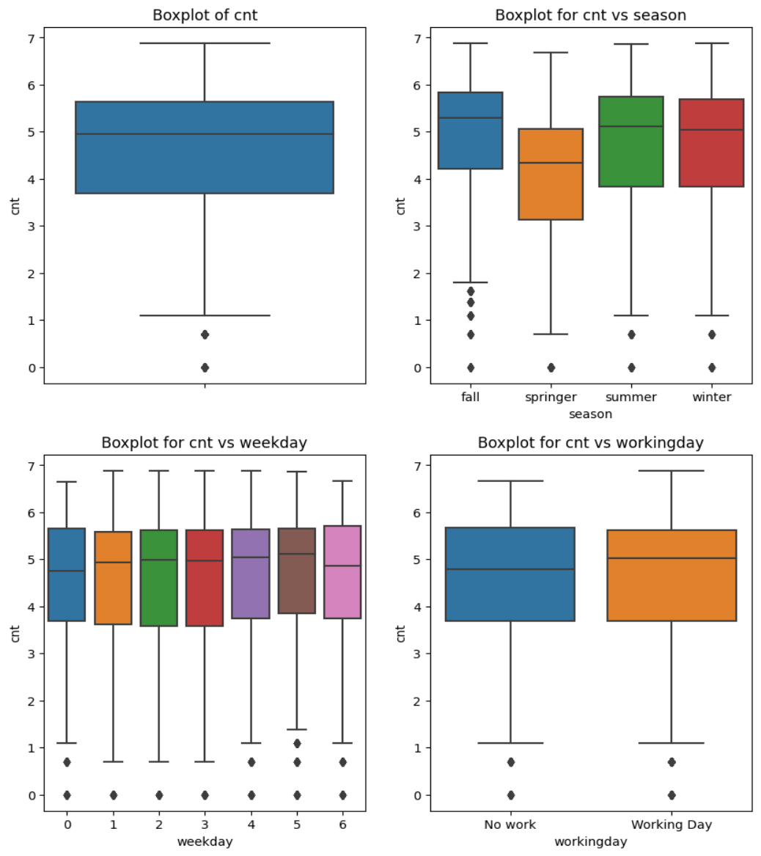
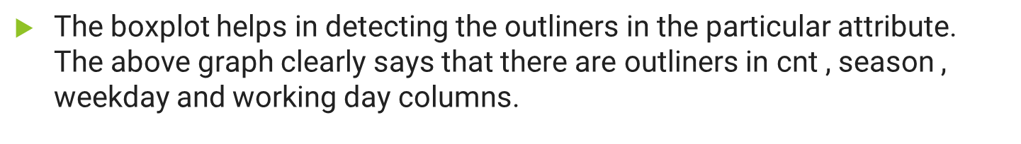
Detecting outliers
Detecting outliers for cnt , workingday , weekday , season

Slide 7
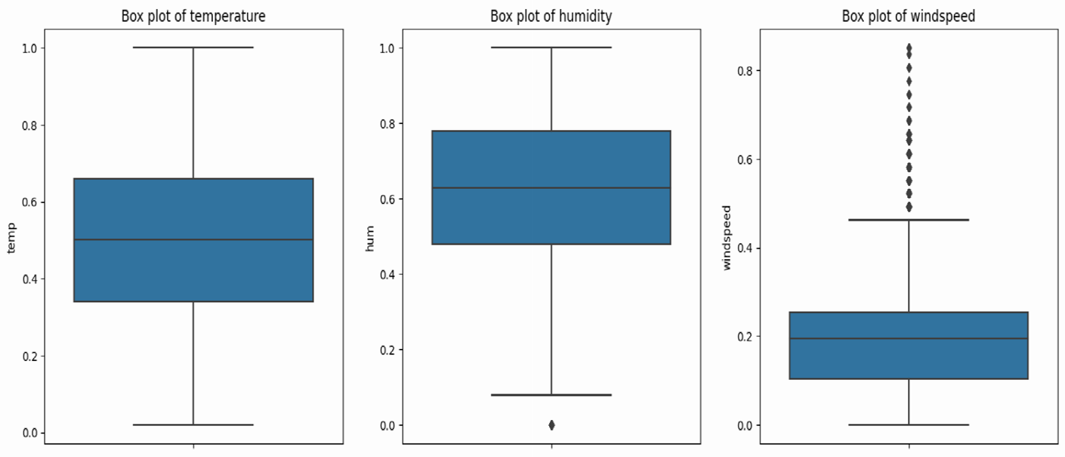

Detecting outliers for temp,hum,windspeed

Slide 8


Slide 9
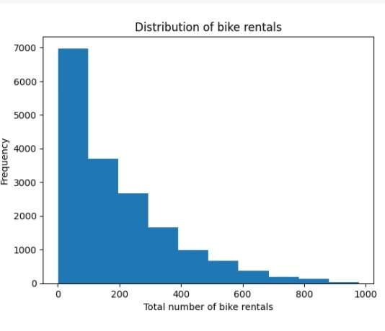
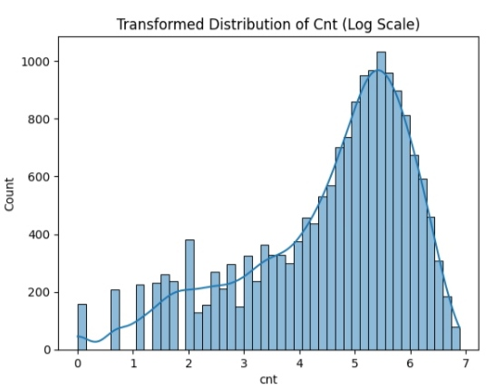
Data Visualization
The histogram and histoplot graph tells that the distribution of target variable is not normal instead it is right skewed. Meaning majority of the data is concentrated on right side of distribution and left side data is populated

Slide 10
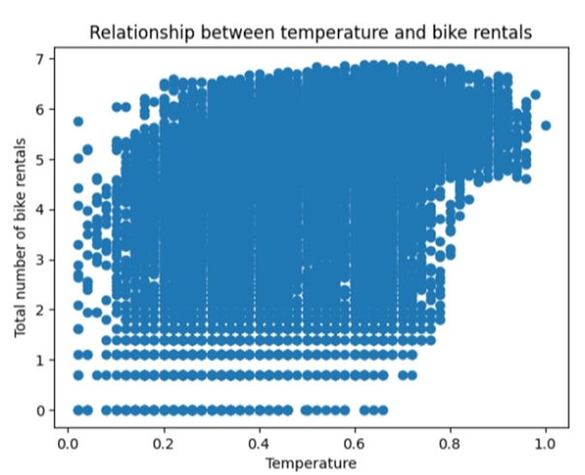
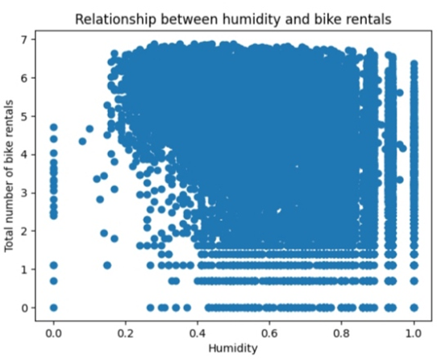
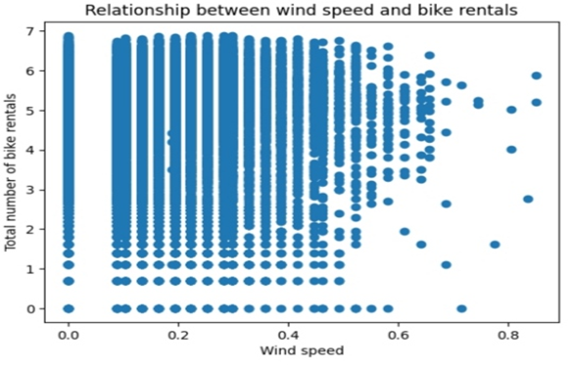
The relationship of weather conditions and count variable
The scatterplot graph for ‘temp’ and ‘cnt’ shows a positive linear relationship, which means that as the temperature increases, the count of rental bikes also tends to increase. The scatterplot graph for ‘hum’ and ‘cnt’ shows a negative linear relationship, which means that as the humidity increases, the count of rental bikes tends to decrease. The scatterplot graph for ‘windspeed’ and ‘cnt’ shows no correlation relationship, which means that the windspeed is not related to target variable.

Slide 11
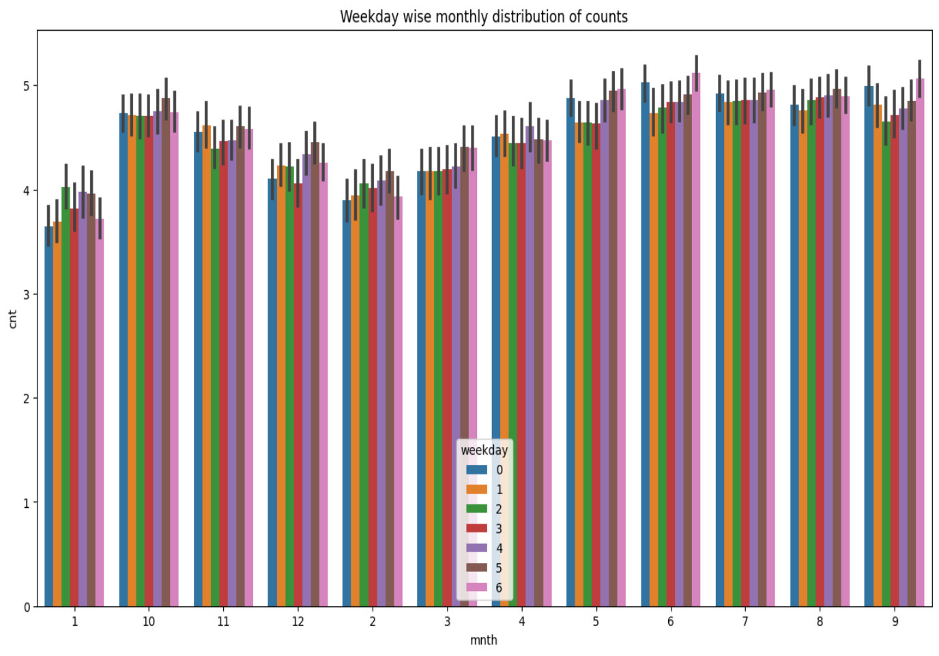
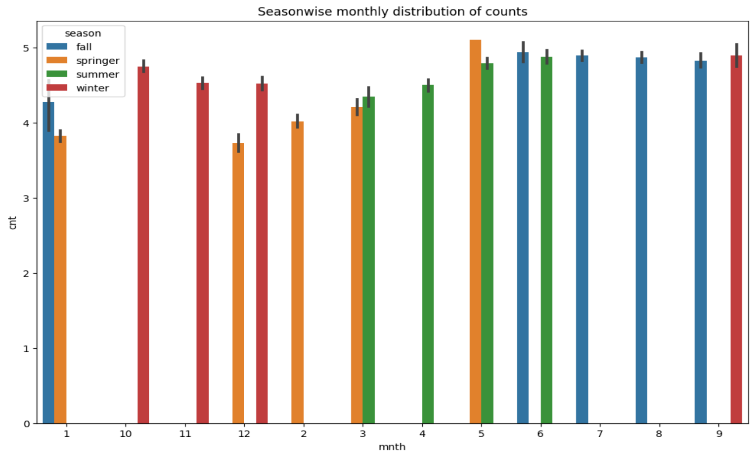
Monthly And Seasonal wise Distribution
In the month wise distribution we can see that the rental counts are higher on weekdays as compared to weekends, with the highest counts on Thursdays and Fridays
From the Seasonal wise Distribution we can see that, the seasons are splitted into 1 -> spring 2 -> summer 3 -> fall 4 -> winter
And the bike rental counts are higher in the summer and fall seasons, with the highest counts in July, August, September and October. On the other hand, the rental counts are lower in the months of December and january.
This suggests that the demand for bikes is higher during the warmer months, possibly due to better weather conditions and more opportunities for outdoor activities.

Slide 12
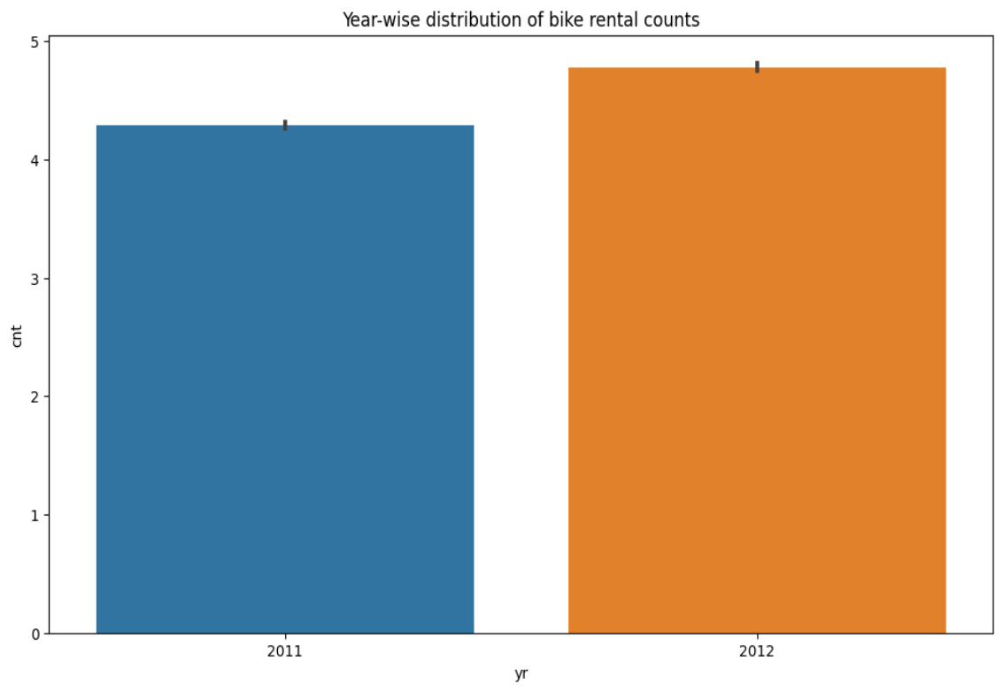
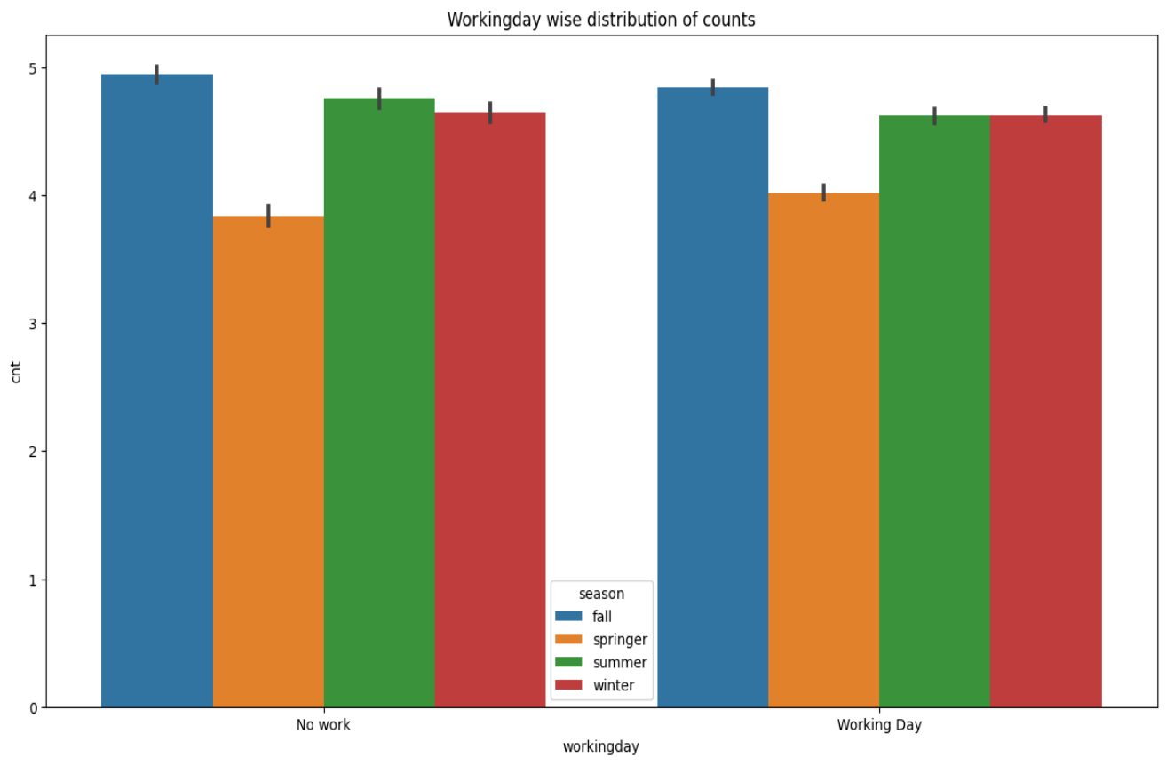
Yearly And Working day wise distribution
In the yearly distribution we observed that Compare to 2011 the more demand for the bike got increased in the year 2012.
From the bar plot of workingday distribution of counts, we observed that the bike rental count is more on working days mostly seen in the fall season.

Slide 13
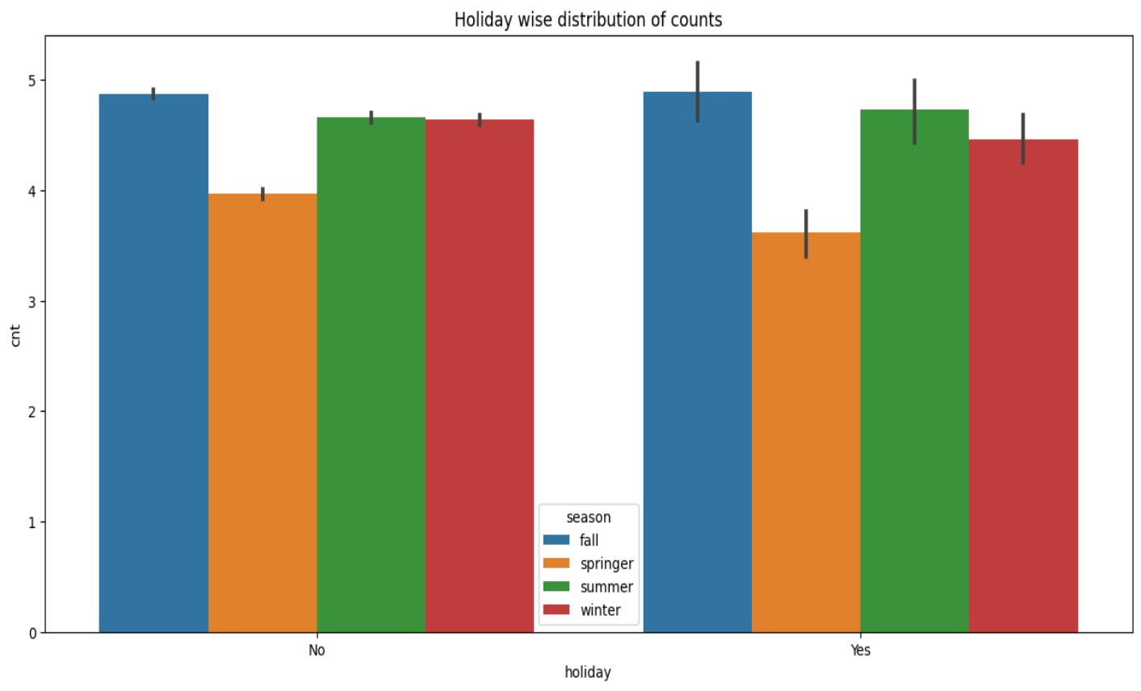
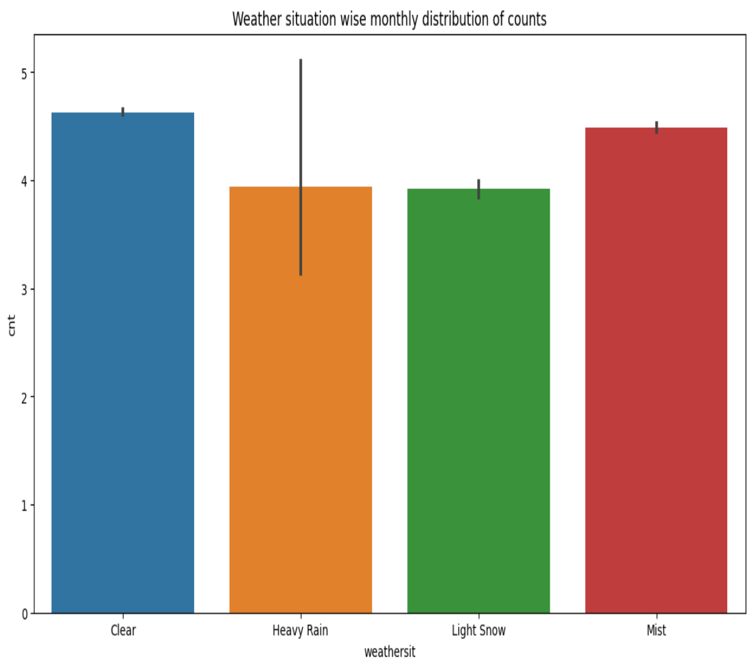
Holiday wise And Weather wise distribution
From The Holiday wise bar plot, we can observed that during no holiday the bike rental counts is highest compared to during holiday for different seasons.
Here, 0->No holiday,
1-> holiday
The Weather wise graph depicts that during clear sky weather condition the count of bikes rented are more than the other weather conditions.

Slide 14
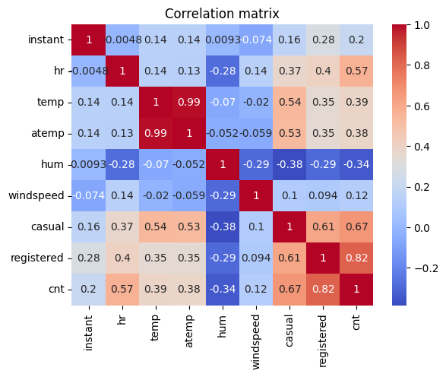
Correlation
The correlation graph shows that the count of total rental bikes has a strong positive correlation with the temperature, feels-like temperature (atemp), and the hour of the day.
The count is negatively co-related to Humidity
Similarly, the cnt is highly correlated with casual , registered so we can also ignore this for future analysis.
Since temperature and atemp are highly positively correlated we can drop atemp

Slide 15
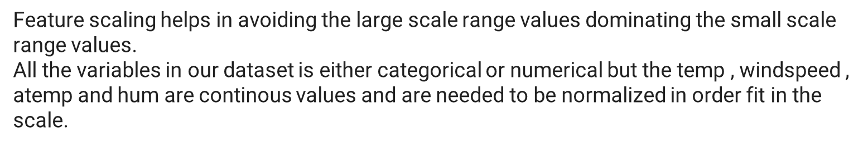
Feature Scaling
Here we applied the MinMaxScaler to the dataset directly to normalize the input variables.
We will use the default configuration and scale values to the range 0 and 1. First, a MinMaxScaler instance is defined with default hyperparameters.
Once defined, we can call the fit_transform() function and pass it to our dataset to create a transformed version of our dataset.
Identify Inputs and Target (Independent and Dependent Variable)
Input (Ind.) = Other all Variable except “Rented Bike Count”
Output (Dep.) = Rented Bike Count

Slide 16
Feature Selection
In Feature selection we used five different features
1 . Recursive Feature Elimination(RFE)
In RFE we used RandomForestRegressor This method fits a model and removes the weakest features until the specified number of features is reached.
Index(['instant', 'hr', 'atemp', 'casual', 'registered'], dtype='object')
2.Univariate Feature Selection:
It is a general best to get a better understanding of the data, its structure and characteristics.
It can work for selecting top features for model improvement
Here we used F_regressor and it will give you best features in the same order if all the features are positively correlated with the target.
Index(['instant', 'hr', 'atemp', 'casual', 'registered'], dtype='object')

Slide 17
3.Tree-Based Feature Selection:
Here we used ExtraTreesRegressor It can be used to compute impurity-based feature importances, which in turn can be used to discard irrelevant features
Index(['hr', 'casual', 'registered'], dtype='object')
4.L1 Regularization:
we used Lasso regularisation to remove non-important features from the dataset and Selection Operator lasso regression is an alternative to ridge for regularizing linear regression .L1 regularization makes some coefficients zero, meaning the model will ignore those features. Ignoring the least important features helps emphasize the model's essential features.
Index(['instant', 'mnth', 'hr', 'casual', 'registered'], dtype='object')
5.SelectFromModel:
The features are considered unimportant and removed if the corresponding importance of the feature values are below the provided threshold parameter.
Selected features: Index(['registered'], dtype='object')

Slide 18
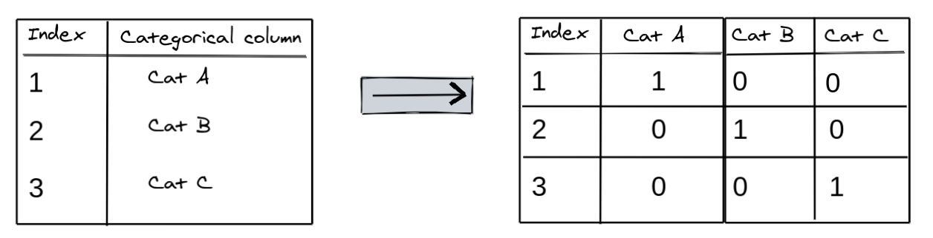
Encoding Data
Since machine learning models can only be trained with numeric data, we need to convert categorical data to numbers. A common technique is to use one-hot encoding for categorical columns. OneHot encoding involves adding a new binary (0/1) column for each unique category of a categorical column -.
OneHot encoding approach eliminates the order but it causes the number of columns to expand vastly. So for columns with more unique values we used other techniques like LabelEncoding

Slide 19
Model Building
We split the dataset into training and test sets.
In this project we used total Six models, so that we can compare the final Root mean square error and R2 score of this models.
We checked the accuracy of our model using different scaling methods & different Regression’s also.
We apply all different scaler and check accuracy difference between scalers
Checking difference between Actual test value and Predicted value

Slide 20
Models Accuracy and Results
Index | Name | Train_R2_Score | Mse_Score | Mae_Score | Test_R2_Score | Mse_Score2 | Mae_Score3
1 | LinearRegression | 0.778463 | 0.477033 | 0.531916 | 0.767303 | 0.490371 | 0.541038
2 | Decision Tree Regressor | 0.991889 | 0.017466 | 0.104767 | 0.991215 | 0.018512 | 0.108742
3 | Random Forest Regressor | 0.999949 | 0.00011 | 0.003954 | 0.991215 | 0.018512 | 0.108742
4 | Support Vector Machine | -580.964 | 1253.137 | 32.32575 | -603.98 | 1274.899 | 32.65213
5 | Gradient Boosting Regression | 0.9992 | 0.0018 |  | 0.9992 | 0.0018
6 | XGBoost | 0.999901 | 0.000213 | 0.009664 | 0.999658 | 0.000721 | 0.015206
As per above results
Train_R2 and Test_R2 Score being near to 1 is considered as a good model.
XGBoost, Gradient Boosting and RandomForestRegressor give us max
R2 score and least Root mean square error on test set and Train set.
The Linear Regression model performed the worst with a score of 0.7788, indicating that it was not able to capture the underlying patterns in the data very well.
NO | ModelName | Model Accuracy Score IN %
2 | Decision Tree Regressor | 99.18%
3 | RandomForest | 99.99%
5 | GradientBoostingRegressor | 99.92%
6 | XGBoost | 99.99%
So, In above results best models are

Slide 21
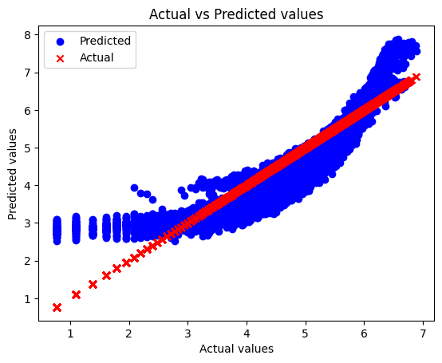
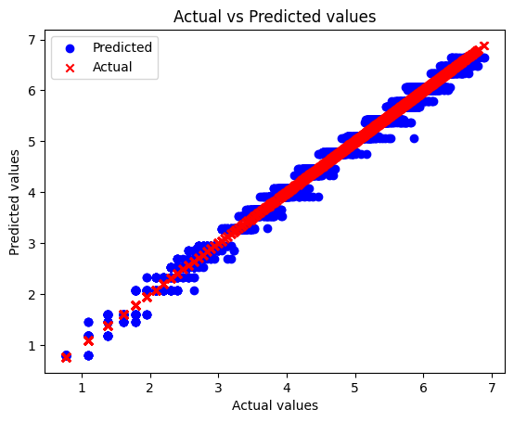
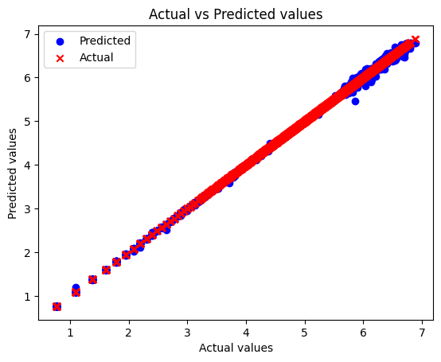
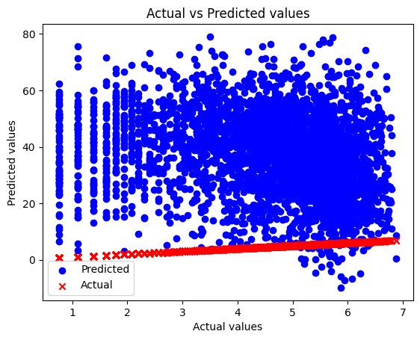
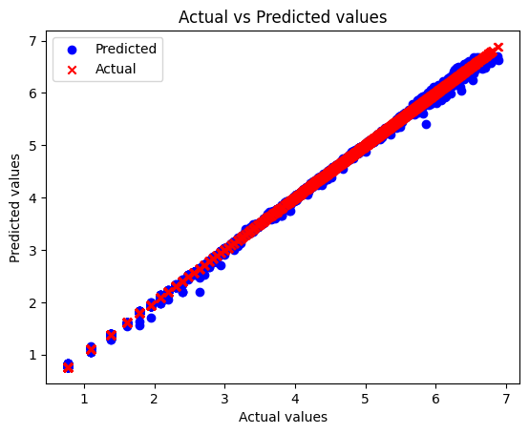

Scatter Plots Of Actual VS Predicted Values
The regression line are the best-fit line for our model.

Slide 22
Model Tuning
In Model tuning we have chosen the important hyperparater such as learning_rate, max_depth, colsample_bytree , subsample, reg_alpha ,reg_lambda and n_estimators.
The max_depth and n_estimators are the same parameters that we chose in all models.Here we are taking an extra that isthe learning
_rate. We call the Boosting Regressor Constructor and define the parameters.
Here we have applied all relevant possible values for each the hyperparamter
# Print the best hyperparameters and best scores for each model
print('Linear Regression:')
print('Best Parameters:', lr_cv.best_params_)
print('Best Score:', lr_cv.best_score_)
print('Decision Tree Regression:')
print('Best Parameters:', dt_cv.best_params_)
print('Best Score:', dt_cv.best_score_)
print('Random Forest Regression:')
print('Best Parameters:', rf_random.best_params_)
print('Best Score:', rf_random.best_score_)
print('Support Vector Regression:')
print('Best Parameters:', svm_cv.best_params_)
print('Best Score:', svm_cv.best_score_)
print('Gradient Boosting Regression: ')
print('Best Parameters:', gbm_cv.best_params_)
print('Best Score:', gbm_cv.best_score_)
print('XGBoost: ')
print('Best Parameters:', xgb_cv.best_params_)
print('Best Score:', xgb_cv.best_score_)
The results of the hyperparameter tuning show that the XgBoost Regression model performed the best with a score of 0.9996.
This suggests that the XGBoost Regression model was able to fit the data very closely and accurately.
The Linear Regression model performed the worst with a score of 0.7788, indicating that it was not able to capture the underlying patterns in the data very well.

Slide 23
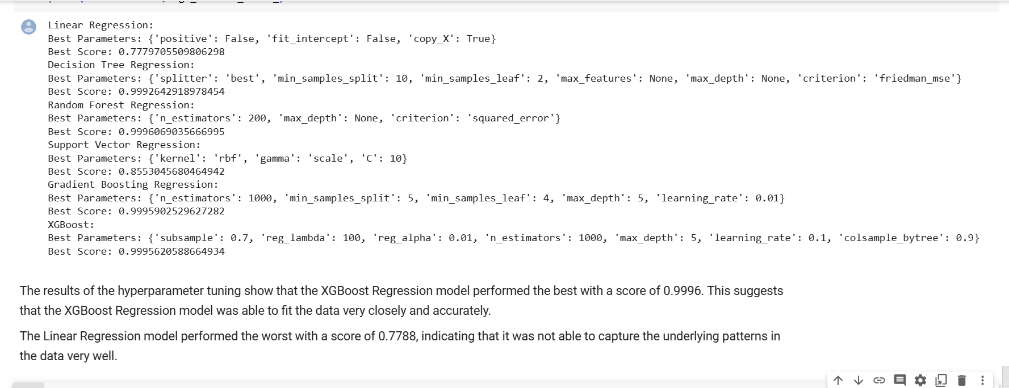
Accuracy of ALL The Models
After Model tuning, the accuracy of the model went from 77% to 99%

Slide 24
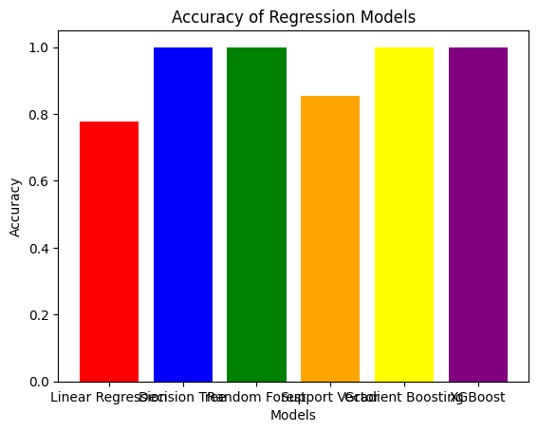
Accuracy of ALL The Models

Slide 25
Conclusions
Most numbers of Bikes were rented in Summer and Fall seasons.
May-October is the peak Bike renting Season, and Dec-Jan is the least preferred month for bike renting.
The demand for bikes is higher during the warmer months, possibly due to better weather conditions and more opportunities for outdoor activities.
Majority of the bike rental belongs to the Working class. This is evident from EDA analysis where bike demand is more on weekdays and working days and mostly seen in the fall Season.
During clear sky weather condition the count of bikes rented are more than the other weather conditions.
Feature and Labels had a weak linear relationship, hence the prediction from the linear model was very low. Best predictions are obtained with XGBoost Regresson model with applied hyperparamter tuning with r2 score of 0.999.

Slide 26
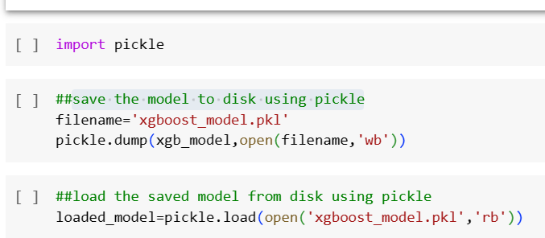
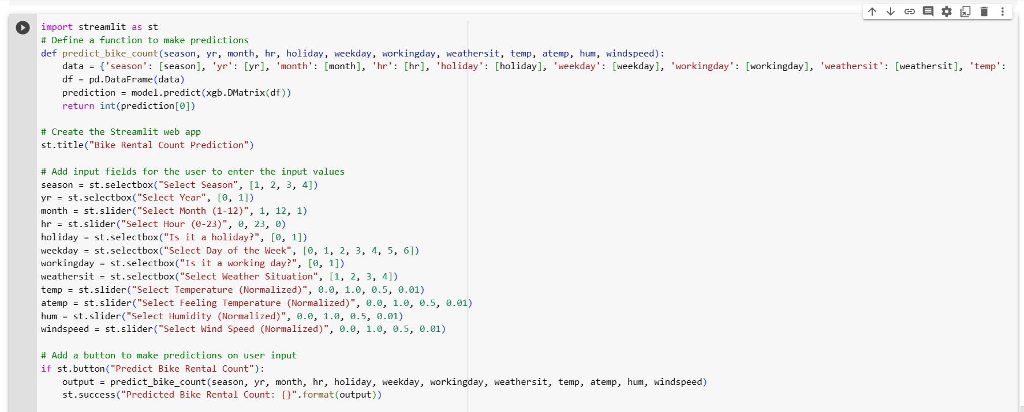
DEPLOYMENT
We saved the model to disk using pickl. After savaing the model we load the model form file
After we deployed our model using Streamlit Web Application

Slide 27

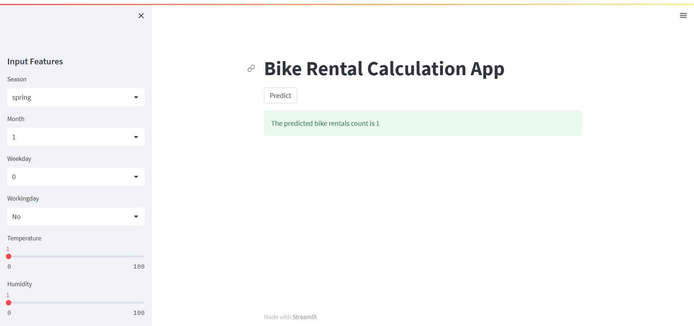

Slide 28
THANK YOU

